Slide 1

The Post-War Norwegian Welfare State Housing Model and the Role of Housing Cooperatives
Tore W. Kiøsterud
Conference on Urbanization and Affordable Housing
Oslo, 2 October 2017

Slide 2
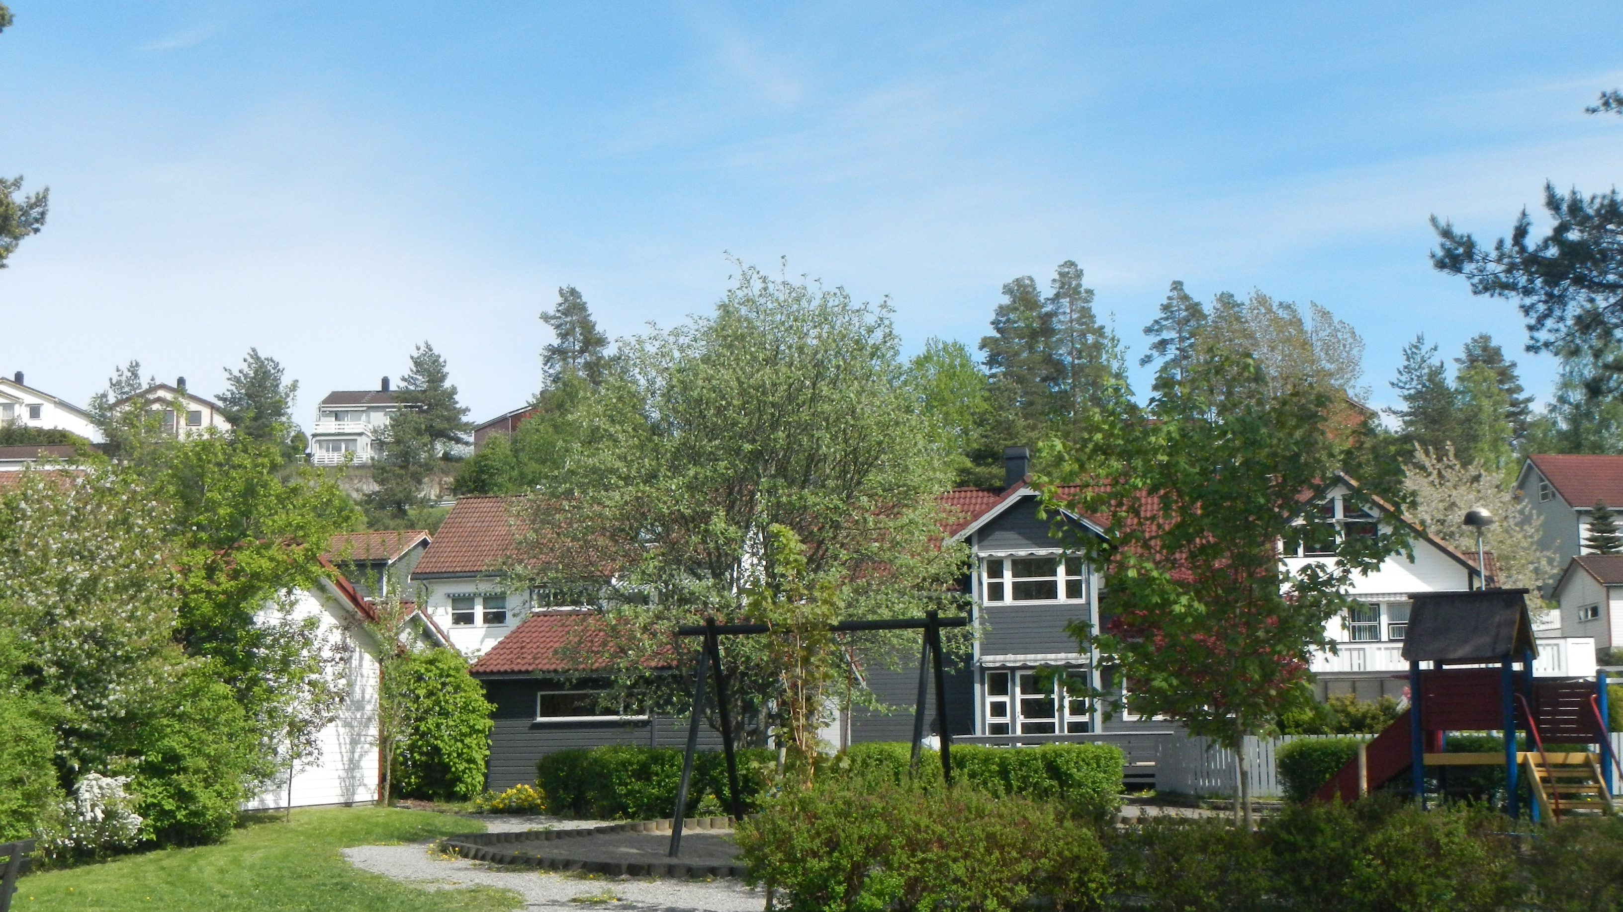
Adequate and affordable housing for all

Slide 3
Main points
Framework: National Governance
Urban – Rural Balance Policy
Housing Policy
  The system and it’s participants
  Urbanization and housing cooperatives
  Targets and the instruments
Achievements
Present challenges

Slide 4
A very brief history
1945 to 1980
1981 to present
Poor housing situation after WWII
Macro-economic Investment strategy; Priority to housing investment.
Regulation and rationing
State Investment Banks
The State Housing Bank
Liberalisation and deregulation
Increasing wealth
Oil revenue
Reduced role of state housing bank
More volatile housing market

Slide 5
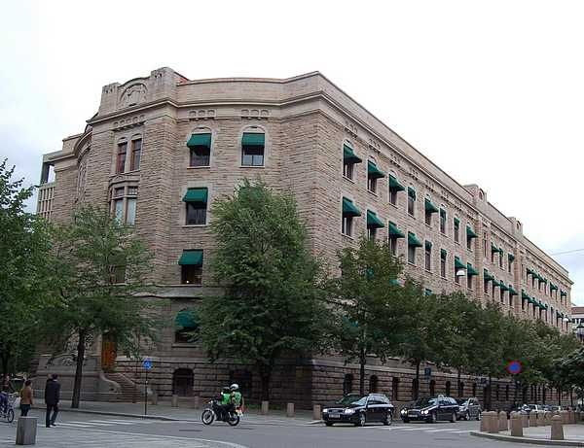
National governance
A Macroeconomic strategy
Welfare objectives
Government legislation, budgets and planning
Mobilisation and utilization of people and natural resources
Investment

Slide 6
Urbanization of Norway- Regional policy
Urbanisation of Norway: Dependent of change in industrial structure, from agriculture, through manufacturing to services. Due to education and change in productivity-and oil and fish!
Regional policies to stabilise the geographic distribution of the population, through spesific sectoral means, subsidies and designated institutions
Investment policies, location of public institutions and private projects, housing loans and subsidies through the State Housing Bank

Slide 7







Housing Policy -
The system and its participants
Central government
Legislation
Financing/ State Housing Bank
Taxation
Subsidies
Local government
Land use
Social housing
Infrastructure
The household
Building industry
Housing cooperations
Self-builders
Investors

Slide 8

Urbanisation and Cooperatives
Housing cooperatives have played a dominant role in urban housing
New cooperative housing were mainly financed by the State Housing Bank
Democratic member organisations
Private, but regulated by 2 laws since 1960
Price regulated up to the 1980-es
Substituted municipal housing
Cooperatives are both developers and owners:
  Housing developers – Example OBOS since 1929
  Organisations of housing cooperatives – Owned by the inhabitants who are free to sell at market price.

Slide 9
Housing Policy –
Targets and instruments
Targets for house building-up to the 1980-es
  Annual number of new houses: 40 000 per year in the 1970’s, 4-year programmes
  Standards: Set by minimum and maximum size of dwellings and cost ceilings
  Housing cost: on average 20 percent of an average industrial wage
Municipal land banks- cost based pricing
State Housing Bank: General mortgage loans and needs tested equity loans , needs tested housing allowance
VAT-compensation up to 1980
Interest deduction on income taxation

Slide 10
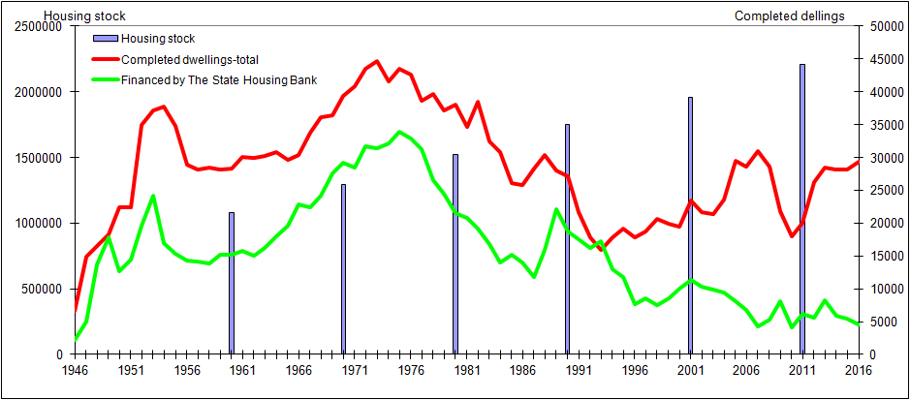
Achievements

Slide 11
Experiences
The investment strategy after the war and up to the 1980s achieved its targets and ambitions: A great improvement in housing conditions for most of the population.
Owner –occupied detached housing and multy-family cooperative housing were main contributors. Totally 80 percent of stock.
Free-market housing based on private financing. Housing market more vulnerable and unstable. Bank and housing crises around 1990.
General housing conditions are good, little substandard housing, but owercrowding has been increasing, especially in the cities and for low-income groups, immigrants, young people and one parent families.

Slide 12
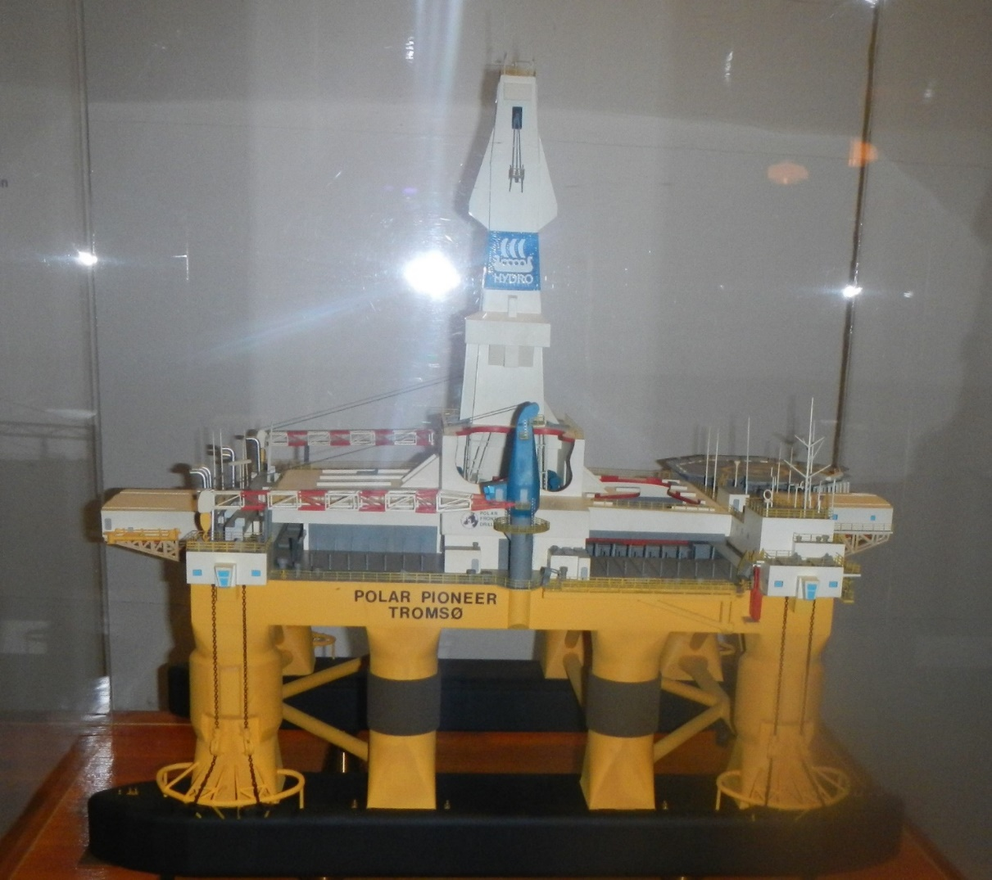
Present Challenges
The Norwegian Economy-from oil drilling to? The critical political economic challenge!
The impact of oil on housing and urbanisation? Wage level pushing, thus on cost and demand of housing.
Urbanisation; oil-relevant job location along the coast

Slide 13


Present Challenges
SDG 11 and NUA-implementation
Housing price increase, access to adequate and affordable housing
The dependence on the distribution of income and wealth;
Young people-students
Elderly people
Immigrants
Low-income households

